Slide 1
CGB1221 – DATABASE MANAGEMENT SYSTEMS END SEM PROJECT REVIEW
Department of Artificial Intelligence
Academic Year: 2024 – 2025 (Even Semester)
Register Number : 927623BAD067
Name : NARESH D
Year : II
Semester : IV
Section : B
Date : 02-06-2025

Slide 2

Title of the Project
A Secure & Intelligent banking system

Slide 3
Abstract
Simple Banking Application, is a secure and user-friendly web platform designed to simplify and automate core banking operations. It allows users to create an account by submitting necessary personal details and identity proofs, after which a unique account number is automatically generated. Once registered, users can perform essential banking functions such as deposit, withdrawal, fund transfer, and apply for loans, all through an intuitive interface.
On the administrative side, the admin panel provides powerful tools for managing user data, verifying documents, monitoring transaction activities, and processing loan approvals. Built using PHP and MySQL, the system ensures robust data encryption, role-based access control, and structured storage of profile images and account details. With its clean architecture and real-time validations, this system delivers a seamless and secure banking experience, reducing manual effort and enhancing operational efficiency for both users and administrators.
Keywords: Simple Banking Application, Account Number, Personal Details, Identity Proofs, Deposit, Withdrawal, Fund Transfer, Loans, Admin Panel, PHP, MySQL, Data Encryption, Access Control

Slide 4
Abstract with CO/PO Mapping
Abstract | CO | POs | PSO
The Smart Banking System integrates DBMS concepts for secure transactions, efficient account management, and real-time balance tracking. Admins can monitor transactions, manage users, and generate reports, ensuring precision and compliance. A loan management module allows users to request loans, with admins controlling approvals. With robust security and a user-friendly interface, it offers a scalable, future-ready banking experience. | CO1 CO2 CO3 C04 | PO1(3) PO2(3) PO3(3) PO5(2) PO10(3) PO11(1) | PSO1(2) PSO2(1)
Notes:
PO1 (Engineering Knowledge)3
PO2 (Problem Analysis)3
PO3 (Design/Development of Solutions)3
PO5 (Modern Tool Usage)2
PO11 (Project Management & Finance)2
PSO1 (Machine Learning, IoT, Data Analytics)2
PSO2 (Ethics & Business Skills)1 (Weak)

Slide 5
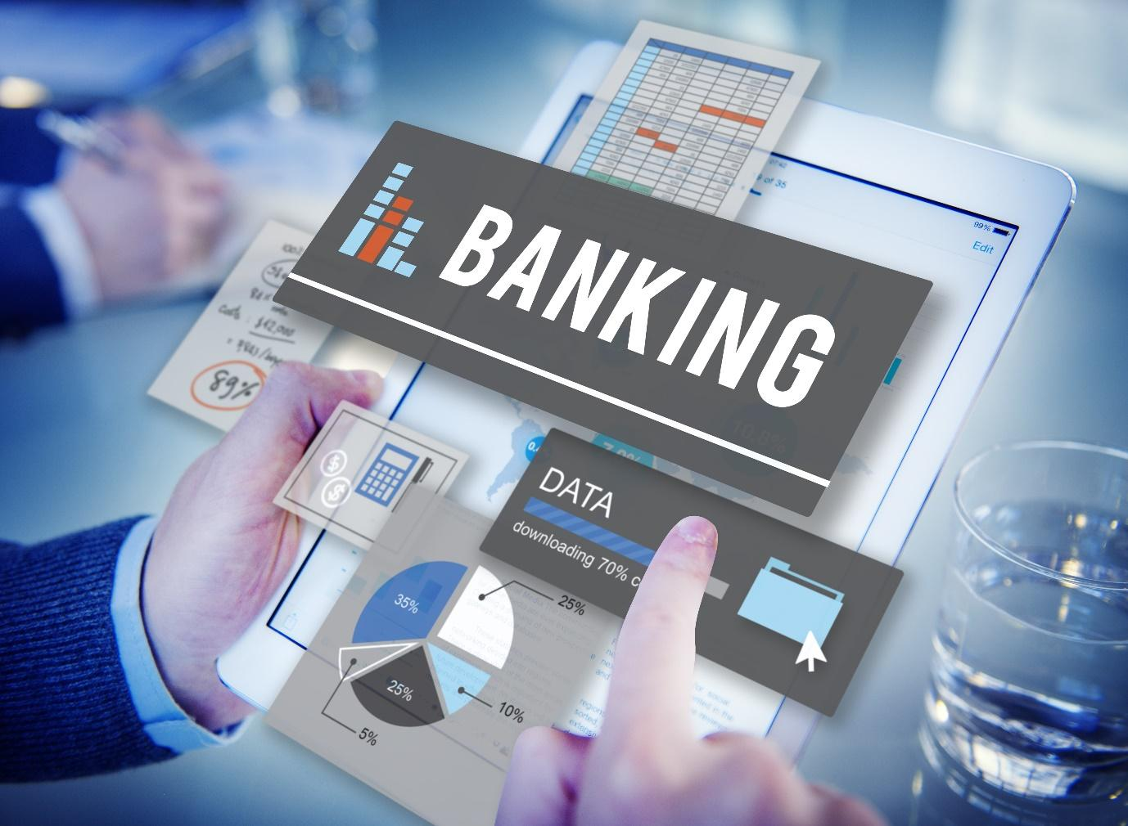
Introduction
The Smart Banking System revolutionizes digital banking by integrating DBMS for security, efficiency, and automation. It ensures seamless transactions, real-time account access, and transparent loan processing.
Secure & Automated Banking – Utilizes DBMS for seamless transactions.
Real-Time Access – Customers manage deposits, withdrawals, and transfers efficiently.
Loan Management – Users request loans; admins approve/reject transparently.
Admin Control – Tools for monitoring accounts, tracking transactions, and generating reports.
Scalable & Reliable – Ensures security, accuracy, and a seamless banking experience.

Slide 6

DBMS Concepts Used
ER Model – Structures relationships between customers, accounts, and transactions.
Normalization – Eliminates redundancy for efficient and consistent data storage.
ACID Properties – Ensures secure, reliable, and fail-proof transactions.
Transaction Management – Controls deposits, withdrawals, and transfers with commit and rollback.
Indexing – Speeds up data retrieval for quick access to account details.
Stored Procedures & Triggers – Automates tasks like loan approvals and fraud detection.
RBAC – Restricts access based on user roles, enhancing security.
Backup & Recovery – Prevents data loss with automated restoration mechanisms.

Slide 7
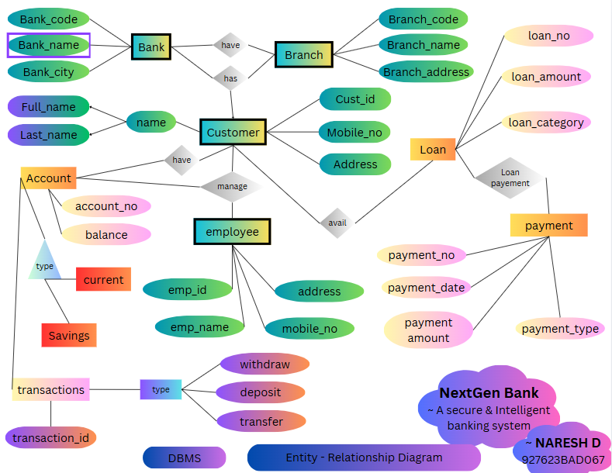
E-R DIAGRAM
Public view link: https://www.canva.com/design/DAGfXYutxHo/US8v4AaewK6J-lKFAvxtiw/view?utm_content=DAGfXYutxHo&utm_campaign=designshare&utm_medium=link2&utm_source=uniquelinks&utlId=hfc461589fa

Slide 8
Proposed System Architecture
Withdraw
Balance - Amount
>=0
Deposit
True
Username,
Password
Found
User Dashboard
Balance + Amount
False
User
Transfer
Loan
Enter account details
Fail
Success
DataBase
View Account Details
Request to bank admin
Not Found
Login
Role
Check DB
Logout
View Admin Details
Approve
Interest %
Reject
Credit loan
Manage Loans
Download excel
Admin
Username,
Password
Admin Dashboard
Found
Full Reports
Update password
Reset Password
Active
User Status update
Block

Slide 9

Proposed System - Description
✅ Role-Based Authentication
Users/Admins enter login credentials, which are validated through the Authentication Module.
If credentials exist in the Database, access is granted to the respective Dashboard.
Invalid users are denied access.
✅ User Dashboard Operations
Users can Withdraw, Deposit, Transfer, and Request Loans.
The system ensures real-time balance validation before processing transactions.
Loan requests are forwarded to the Admin Dashboard for review.
Users can track their transaction history and account details.

Slide 10

Proposed System - Description
✅ Admin Dashboard Operations
Admins can view and manage customer details.
Admins can approve/reject loan requests based on criteria.
Generates detailed financial and transactional reports.
Admins can reset passwords and update user statuses (Active/Blocked).
✅ Secure Data Handling & Processing
The Database acts as the central hub, storing user credentials, transaction records, and loan details.
All operations, including loan approvals and transaction processing, are securely validated.
✅ Smooth Exit & Session Management
Users/Admins log out after completing operations, ensuring data security and session termination.

Slide 11

List of Modules
🔐 The Sentinel of Security Authentication and Password Management Module
🧑‍💼 The Custodian of Clients Client Management Module
💸 The River of Wealth Transaction and Payment Module
🏦 The Architect of Aspirations Loan Management Module
📊 The Oracle of Insights Reports and Analytics Module
🛡️ The Throne of Command System Administration and Dashboard Module

Slide 12



Module Description
The Sentinel of Security
This module ensures safe and secure access to the system. It handles user and admin login processes, session management, password encryption, and provides flows for password recovery and reset.
The Custodian of Clients
Here, all user-related activities are managed. This module allows admins to create, view, edit, and search for user accounts. It also provides options to manage profiles, and freeze/unfreeze accounts, along with tracking user-specific stats and details.
The River of Wealth
This module is the backbone of financial transactions. It manages deposits, withdrawals, and transfers between user accounts. Additionally, it tracks transaction histories, ensuring every financial movement is recorded and accessible.

Slide 13



Module Description (Cont..)
The Architect of Aspirations
This module handles everything related to loans. It lets users apply for loans, while admins can approve or reject requests. It also keeps track of loan histories and repayments, ensuring transparency and efficiency in loan management.
The Oracle of Insights
Providing key insights into system performance, this module generates detailed reports and visual analytics. Admins can view transaction trends, user activity, and financial health through charts, graphs, and reports, helping to drive data-informed decisions.
The Throne of Command
The central hub for all administrative actions. This module gives admins access to real-time system metrics, controls for managing users and transactions, and provides a user-friendly overview panel to monitor the health and operations of the system.

Slide 14





Software Specification (Tools / Programming Languages used)
Frontend (Client-Side)
HTML: Defines the structure of web pages.
CSS: Styles the page layout and design.
JavaScript: Adds interactivity and dynamic features.
Backend (Server-Side)
XAMPP: Provides the local server environment (Apache + MySQL).
PHP: Handles server-side logic and communication with the database.
MySQL: Stores and manages data (e.g., user info, transactions).
14

Slide 15
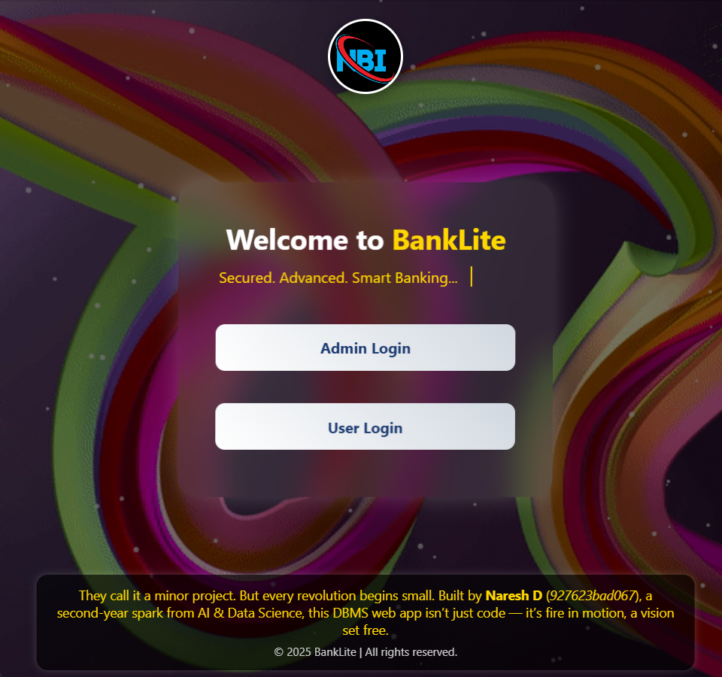
Main page (Role selection)

Slide 16
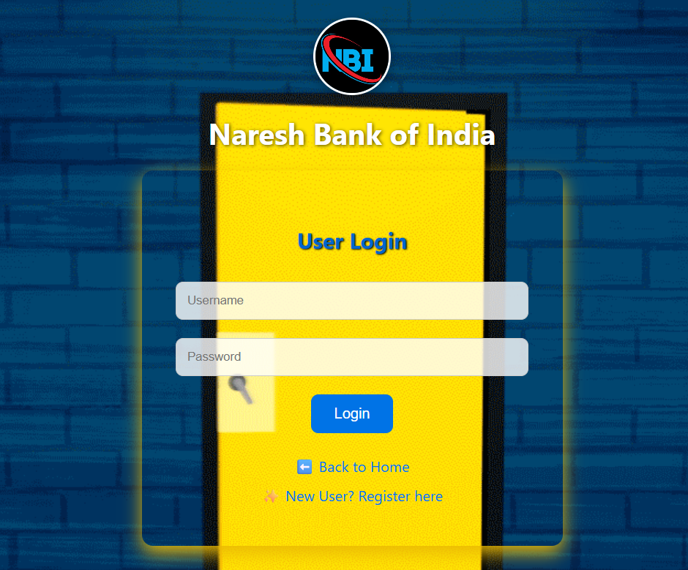
User login page

Slide 17
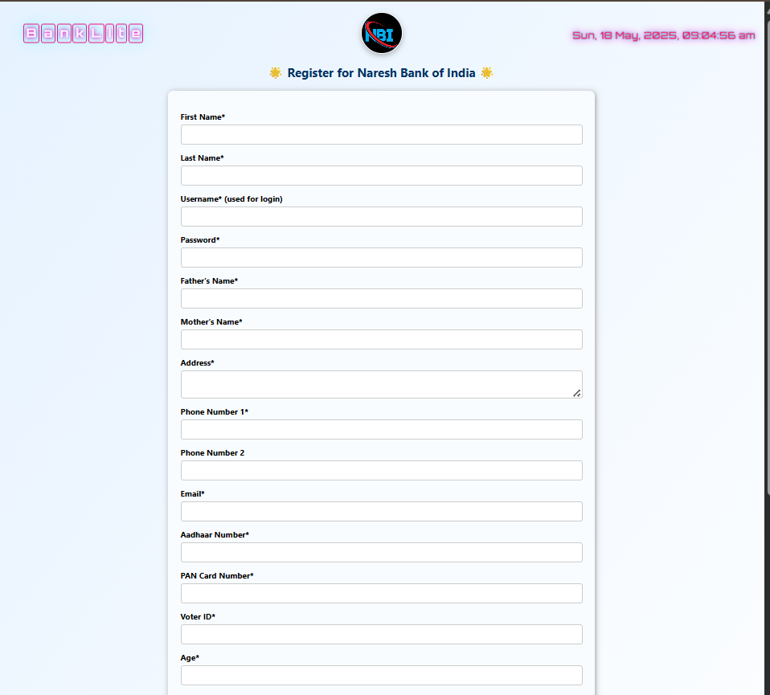
New user Registration page

Slide 18
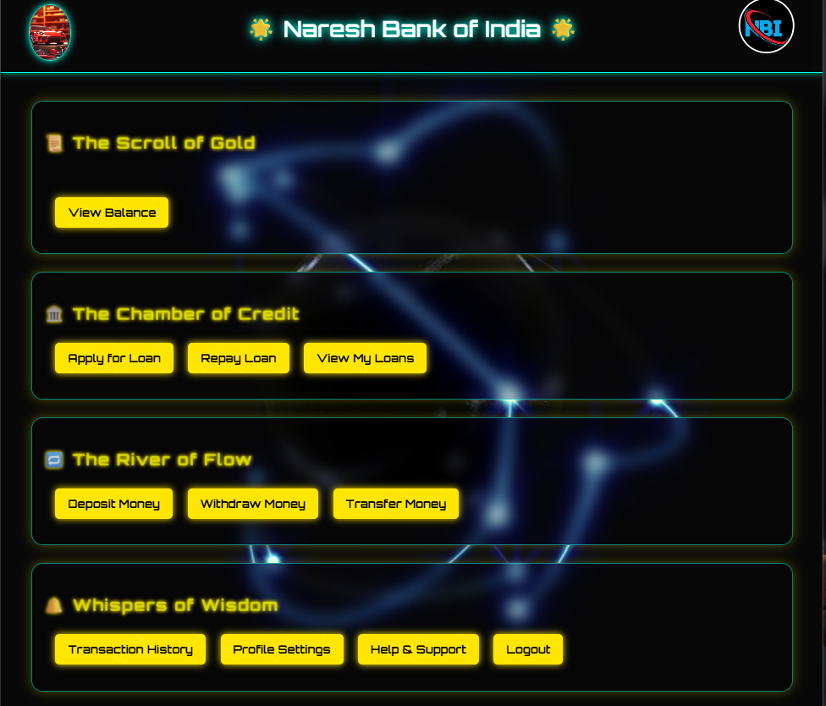
User dashboard

Slide 19
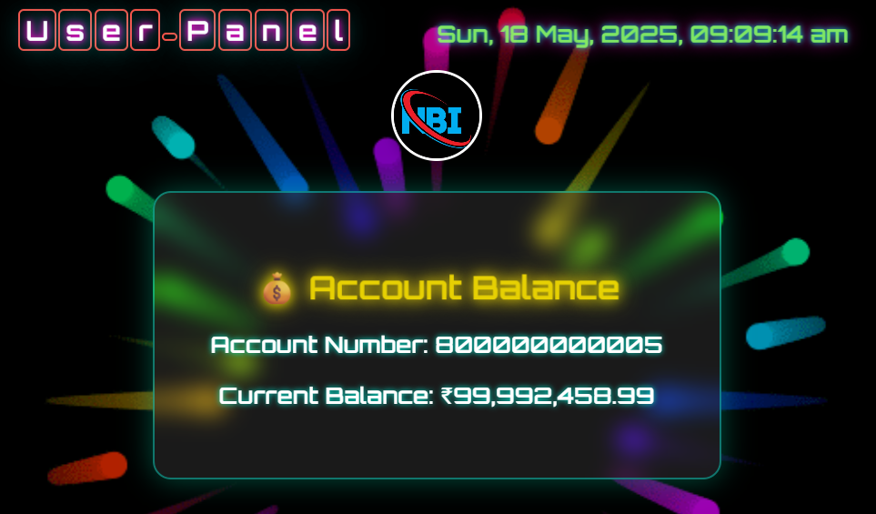
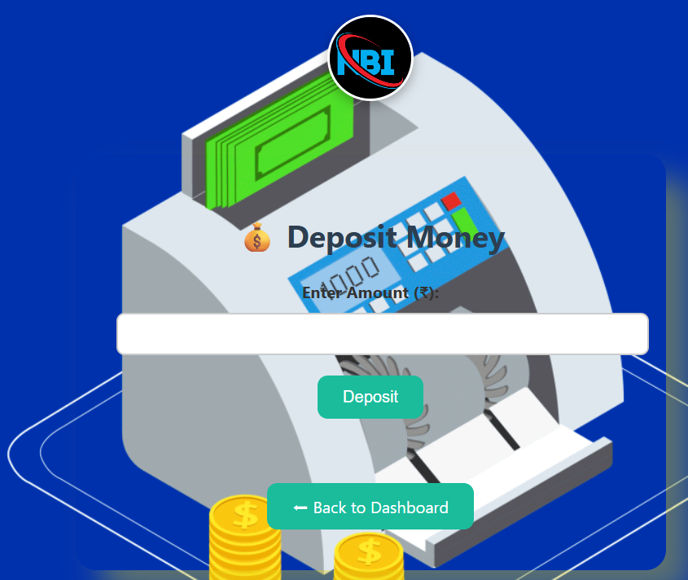
User operations
Fig. User balance page
Fig. User money deposit page

Slide 20
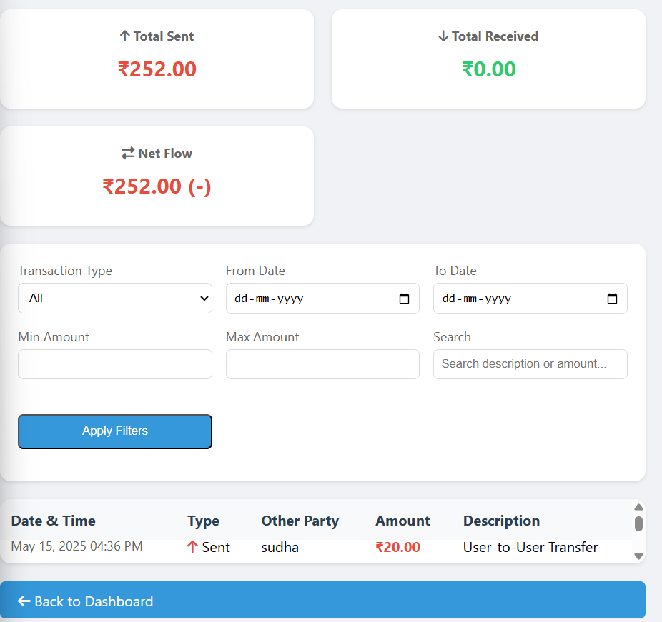
User transactions page

Slide 21
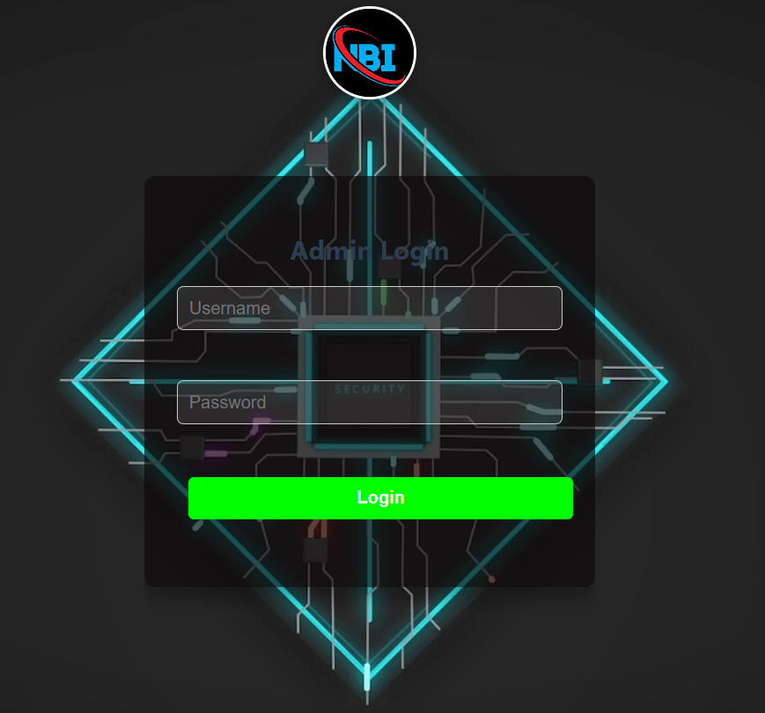
Admin login page

Slide 22
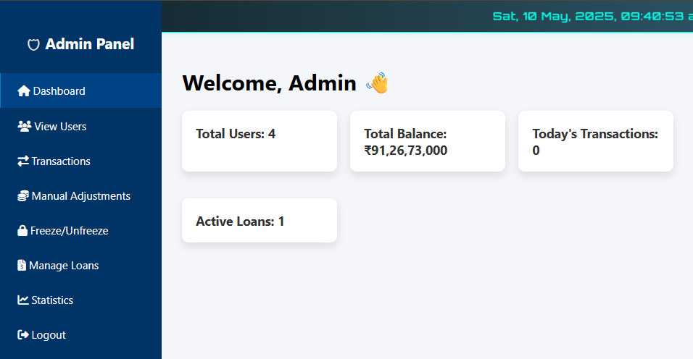
Admin page Screen shots

Slide 23
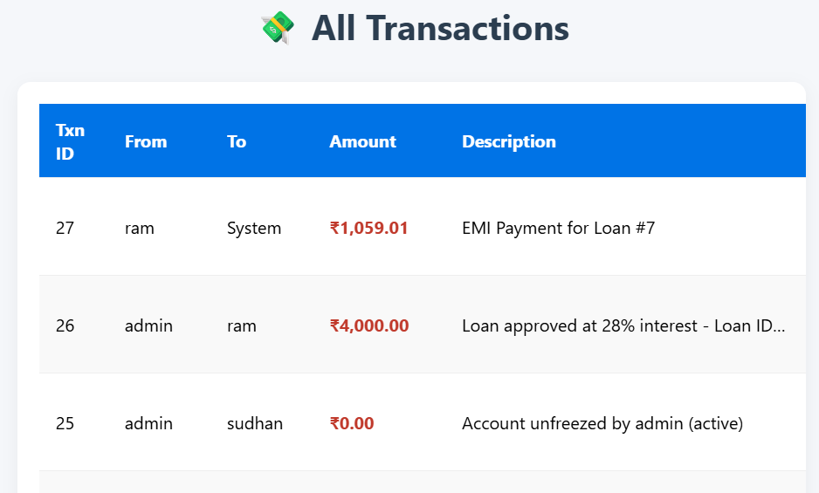
Admin all transactions page

Slide 24
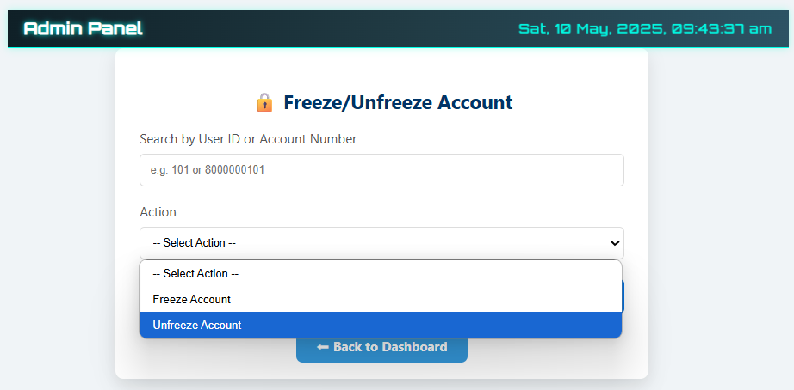
Admin operations

Slide 25
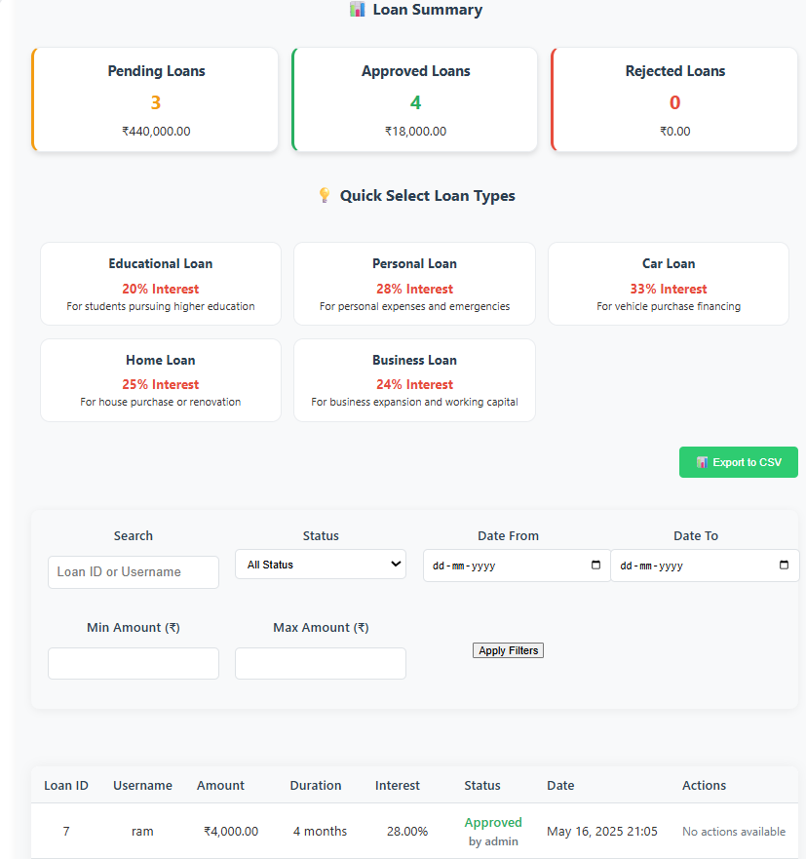
Admin loan management page

Slide 26
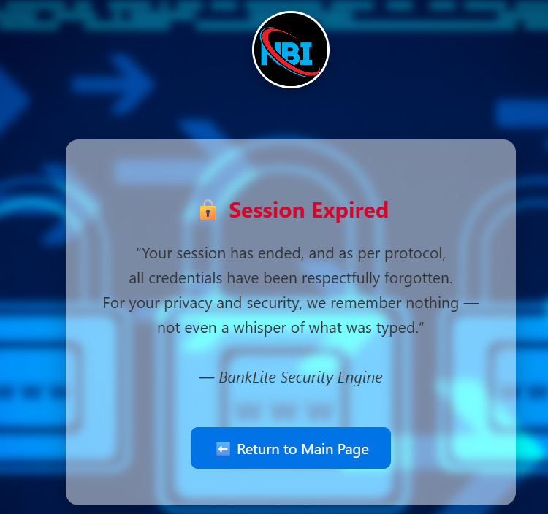
Session expired message

Slide 27

Conclusion
The Simple Banking Application showcases a secure, efficient, and user-friendly banking solution, bridging the gap between simplicity and functionality. Through modular architecture, graphical insights, and robust features like user management, transactions, and loan processing, it empowers both users and admins with clarity and control. This project is a step toward smarter digital banking, built with passion, precision, and a forward-thinking vision.

Slide 28
Project status
The Sentinel of Security - 100% Authentication and Password Management Module
The Custodian of Clients - 100% Client Management Module
The River of Wealth - 100% Transaction and Payment Module
The Architect of Aspirations - 100% Loan Management Module
The Oracle of Insights - 100% Reports and Analytics Module
The Throne of Command - 100% System Administration and Dashboard Module

Slide 29

Future works
✅ Planned Future Enhancements
Real-time API integration
QR code generation and scanning
Scan and Pay (contactless payments)
In-app online shopping
Utility bill payments
Ticket bookings (bus, train, flight, movies)
Loan prediction based on transaction and credit history
Gamified saving challenges

Slide 30
Thank You
ANY QUERIES???

